Slide 1
Rate Analysis by Parameter for Historic Accelerator Data
Nathan Schneider

Slide 2
Project Requirements
Get rate of valid dust events per hour from database data
Obtain data directly from the MySQL database
Searchable by velocity range, dust material, specific dust ID, date range, and given experiment ID
Graphical Interface for ease of use

Slide 3
MySQL Stored Data
All 5.5 million dust detection events, w/ data and timestamps
Velocity Setting Changes with timestamps for the PSU (Particle Selector Unit)
Experiment ID with timestamps
Database run_times table has incorrect data past June 2016, so need to calculate running times differently
Task was to find “active sessions” and calculate rates within them

Slide 4
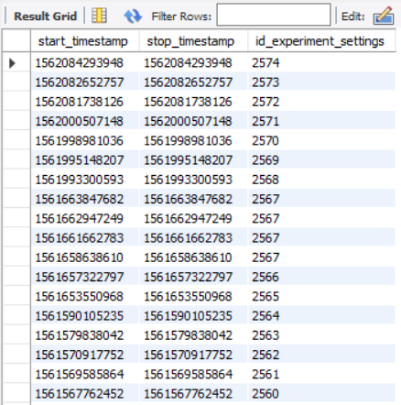
Problematic Approaches
Previously Attempted to define active sessions by stored and timestamped setting changes for the dust source, including needle voltage, frequency
These source settings had a five-minute delay between changes and backup to the database, meaning if the rest of the system was shut down before the backup, the settings were not saved to the database

Slide 5
Chosen Approach
Dust Event: Timestamp, velocity, estimate quality, dust ID
PSU setting change: Timestamp, velocity min, velocity max
Velocity: 6342m/s
Dust ID: 97
Estimate Quality: 4
ExpID: 265
Experiment change: Timestamp, experiment ID
ExpID: 266
V min: 5km/s
V max: 10km/s
V min: 30km/s
V max: 40km/s

Slide 6
Chosen Approach
1: Split into group by first and last detection, given some gap length
20 Minutes

Slide 7
Chosen Approach
2: Tag and Segment based on velocity changes
V min: 5km/s
V max: 10km/s
V min: 30km/s
V max: 40km/s
V min: 5km/s
V max: 10km/s
V min: 5km/s
V max: 10km/s
V min: 30km/s
V max: 40km/s
V min: 30km/s
V max: 40km/s

Slide 8
Chosen Approach
3: Segment and Tag based on experiment changes
ExpID: 265
ExpID: 266
V min: 5km/s
V max: 10km/s
V min: 5km/s
V max: 10km/s
V min: 30km/s
V max: 40km/s
V min: 30km/s
V max: 40km/s
V min: 5km/s
V max: 10km/s
ExpID: 265
V min: 5km/s
V max: 10km/s
ExpID: 265
V min: 30km/s
V max: 40km/s
ExpID: 265
V min: 30km/s
V max: 40km/s
ExpID: 266
V min: 30km/s
V max: 40km/s
ExpID: 265

Slide 9
Chosen Approach
4: Tag sessions with dust type
Dust ID: 97
Dust ID: 97
Dust ID: 97
Dust ID: 87
Dust ID: 87
V min: 5km/s
V max: 10km/s
ExpID: 265
V min: 5km/s
V max: 10km/s
ExpID: 265
V min: 30km/s
V max: 40km/s
ExpID: 265
V min: 30km/s
V max: 40km/s
ExpID: 266
V min: 30km/s
V max: 40km/s
ExpID: 265
V min: 5km/s
V max: 10km/s
ExpID: 265
DustID: 97
V min: 5km/s
V max: 10km/s
ExpID: 265
DustID: 97
V min: 30km/s
V max: 40km/s
ExpID: 265
DustID: 97
V min: 30km/s
V max: 40km/s
ExpID: 265
DustID: 97
V min: 30km/s
V max: 40km/s
ExpID: 266
DustID: 97

Slide 10
Chosen Approach
5: Remove dust events with low estimate quality

Slide 11
Chosen Approach
Use session durations to generate runtime data
V min: 5km/s
V max: 10km/s
ExpID: 265
DustID: 97
V min: 5km/s
V max: 10km/s
ExpID: 265
DustID: 97
V min: 30km/s
V max: 40km/s
ExpID: 265
DustID: 97
V min: 30km/s
V max: 40km/s
ExpID: 265
DustID: 97
V min: 30km/s
V max: 40km/s
ExpID: 266
DustID: 97

Slide 12
Chosen Approach
For each selected session, add its duration to a run time histogram with velocity range bins
40 min
V min: 5km/s
V max: 10km/s
ExpID: 265
DustID: 97
Duration: 40 min
0-1, 1-2, 3-4, 4-5, 5-6, 6-7, 7-8, 8-9, 9-10
km/s

Slide 13
Chosen Approach
Add all sessions within user parameters of dust material, dust ID, date range, and experiment ID to a run time histogram
Add the enclosed dust events to another histogram
Divide the values, then sum over the intended velocity range to get a single rate for the user parameters

Slide 14
Other Information
Histogram bins are accurate to .1km/s
As of July 2019, fetched data is totaled at 32 MB ~ 15s on localhost database
Local processing requires < 2 seconds
Python requires installation of mysql.connector, which can be installed through the MySQL installer or pip.
Code and documentation is held in GitHub repo,
github.com/nathan-m-schneider-22/Dust-Accelerator-Database-Analysis

Slide 15
Testing
All segments of the code were tested on
1: Small, self made data set for easy confirmation of function
2: Data from past 2 weeks, results confirmed with operators
3: All historic data, to check larger trends and dealing with problematic data
Each tagging and segmentation step was confirmed by cross-checking parallel but unused data, such as
Checking that observed particle velocity ranges matched the tags of the sessions
Tagged experiment IDs matched the experiment IDs stored for each dust event
Comparing estimated rates on previous runs

Slide 16
Potential Problems/Limitations
For low event count sessions, the start and end boundaries from the first and last detection may not accurately reflect the true start and end of the session. There are 900 session with 2 or less detections, making up 21 hours of runtime.
Total runtime of all sessions totals to 2800 hours, falling short of 4450 hours of shaft run time.
686 sessions with 0 particles in them, totaling 7.7 hours of runtime
78420612
78420612

Slide 17
Difficulties in Development
Managing Python environment on Windows, particularly pip installation of necessary packages
Lacking/incorrect data in the database, such as the run time table, and the backing up of dust source settings failing during shutdown
Run times generated by source settings produced sessions with total runtimes above 6500 hours, above what the 4450 that the pelletron shaft was running.

Slide 18
Work going forward
Create a GUI for easy usage of the lookup and processing system
Update the mySQL server from 5.1.73 to 5.5 or later to allow python3 tools to access data
Possibly streamline SQL query to reduce data retrieval time to almost zero OR make local storage and fetch only new data
Make the process more modular, in case it is needed to integrate with another system
Tweak low-count sessions to give more accurate results by defining start and stop times from dust source settings.
Fix the runtime table of the database with this information, or replace it with a session table.

Slide 19
Improvements
LabVIEW GUI
Design Iteration
Control fixation
Backend validation
Python integration
Graphics generation
Windows setup tools
Python documentation and README

Slide 20
Work Going Forward
Mac/Linux executable setups
Mac/Linux LabVIEW Executables
LabVIEW Documentation
Other database insights?
Optimal Rate
Setup for connection to external MySQL server

Slide 21
Windows Demo Version
https://bit.ly/2Z7DOXY
Clone my GitHub repository, use the Demo folder specifically
Executable and Setup tools are only Windows compatible, .vi files are available in the main folder
Demo pulls from saved data included in the .pkl file, no need to draw from database

Slide 22
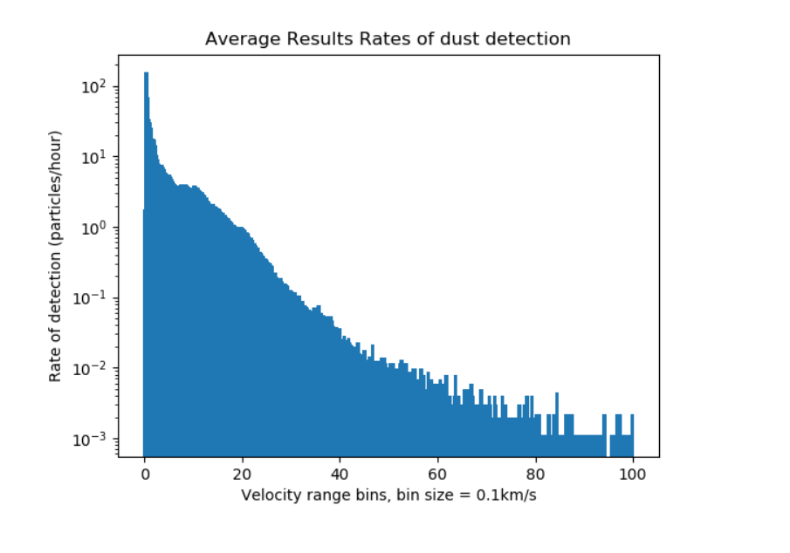
Performance Factor
Performance Factor is a measure of how the session compares to a hypothetical session that follows the mean of the rate data.
Session
445 dust events in 2 hours
5km/s – 30km/s

Slide 23
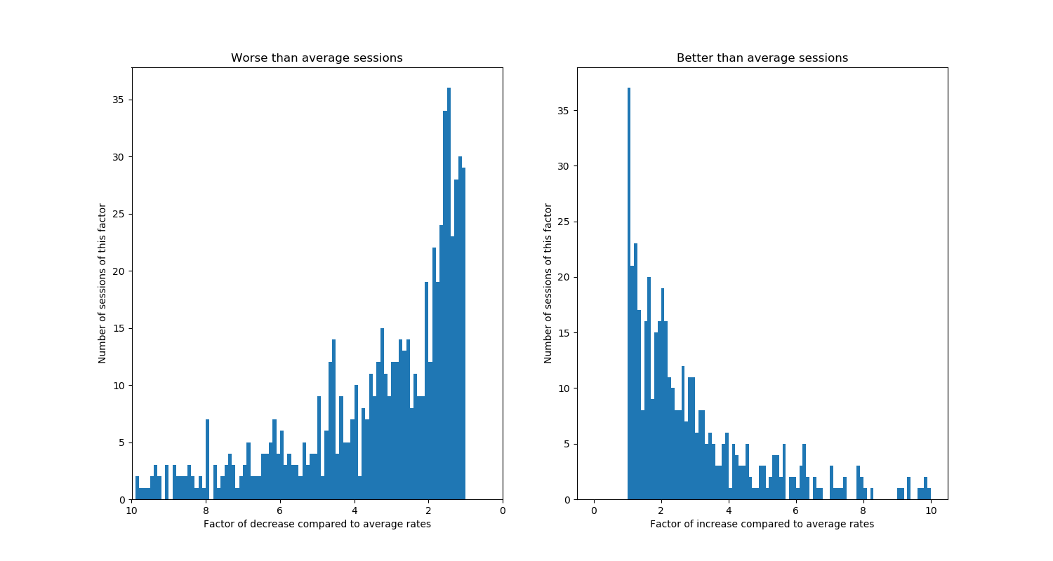
Performance Distribution

Slide 24
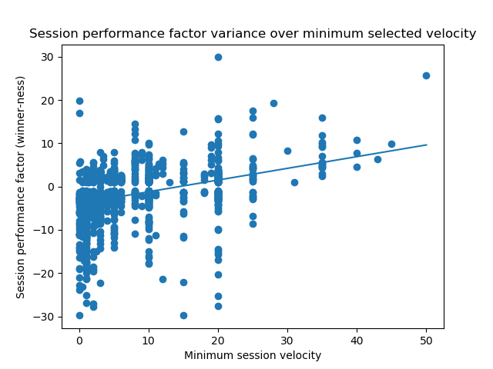
Does increasing min v change performance?

Slide 25
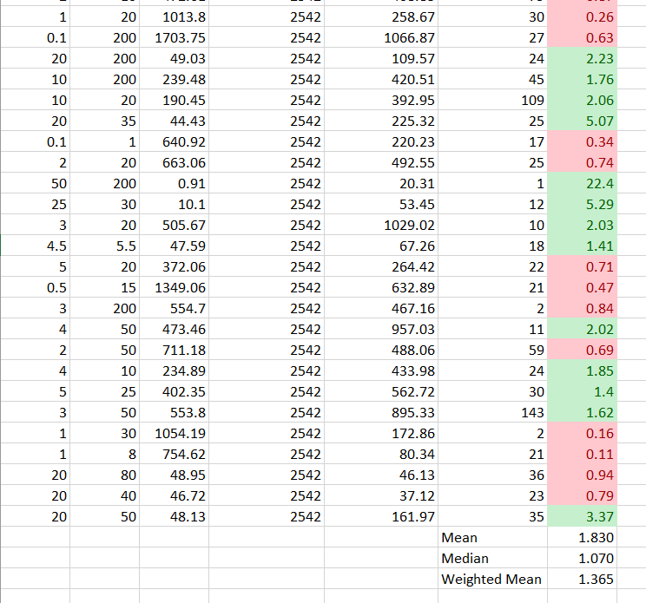
Increased Specificity and Performance

Slide 26
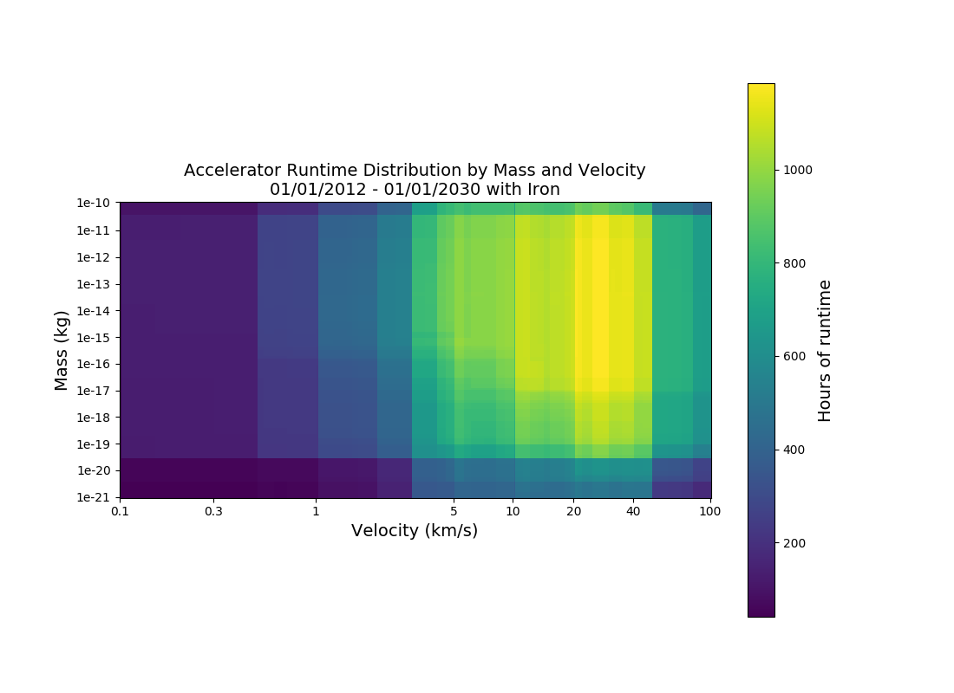

Slide 27
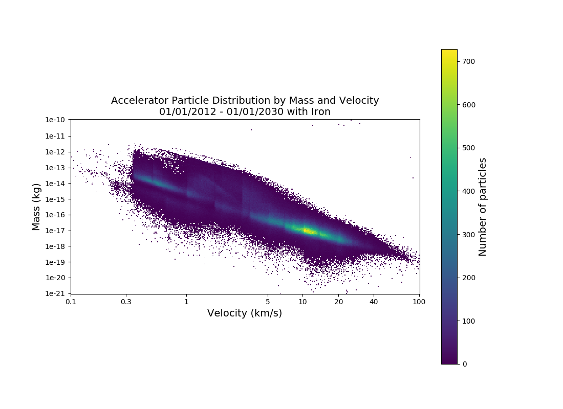

Slide 28


